Slide 1



Slide 2
Write for a Living
Write for a Living
6 Weeks 8 Mentors 4 Languages 1 YU Application
Every other Wednesday night, at 6:30PM

Slide 3
We are going to
Create an App
(With the help of 8 community members!)
for
Yeshiva University
that shows.....

Slide 4

ALL Events
Campus
on

Slide 5
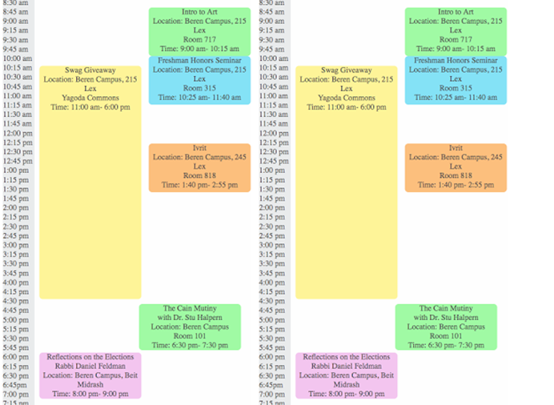

It Will Look Something Like This…
Today
All YU Events!
HTML:Atara Huberfeld
Notes:
Events szed by time length
Color coded based on your schedule, your interests, the food provided, and MORE!
Register for events, tell your friends you’re going
Upload your pics!

Slide 6
Learn Git/Terminal
Use Ruby/Get data
Study Rails/Build site
HTML/CSS
To Do:
5) Publish Application!
Notes:
What does this mean?

Slide 7
What is A.....?
1) Database
2) Data Source
3) Web Platform
4) Front End

Slide 8
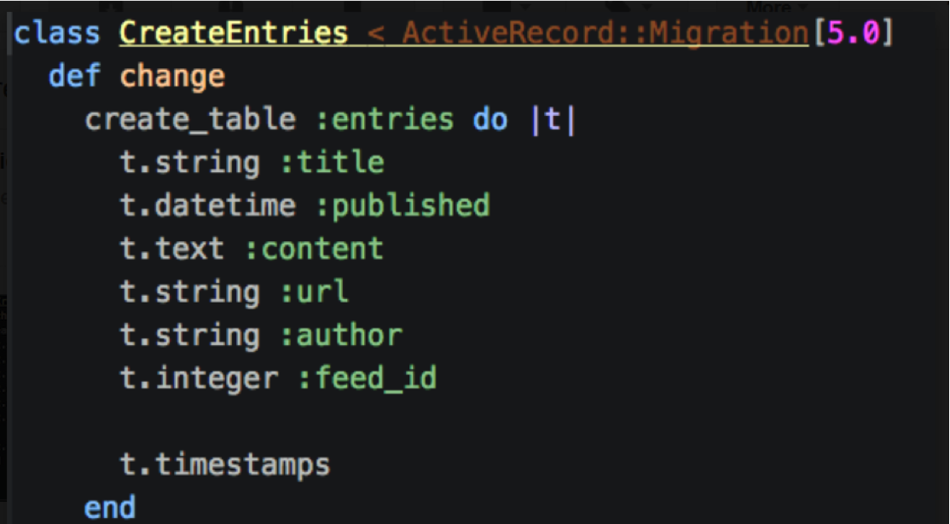
1) Database
Ruby: Daniella Penn
Notes:
A place to store the data- like we store goods in a warehouse.
Like a brick & mortar warehouse, a database must be well laid out (structured)
Data is usually stored in tables, with columns and rows. It is like a really big excel file in the sky - and it makes manipulating data really easy!
We are going to write our database in : RUBY

Slide 9
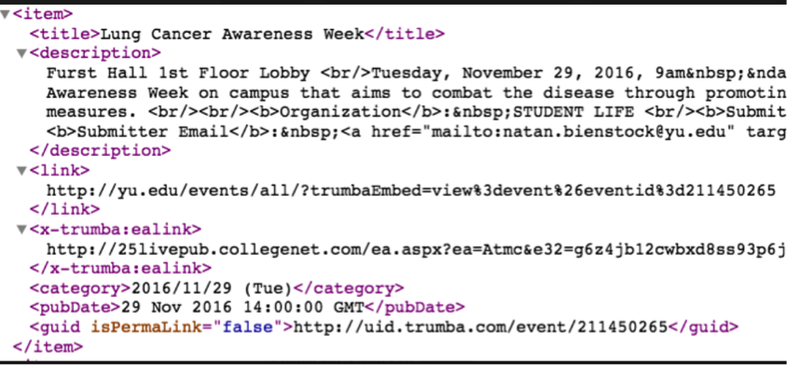
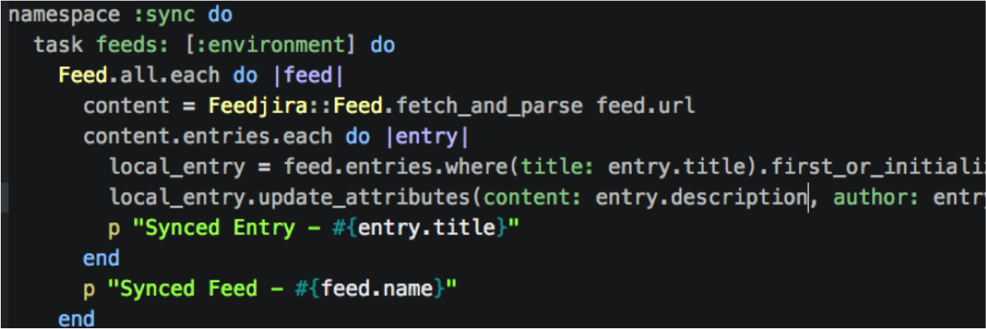
2) Data Source
RSS FEED, from YU.EDU/EVENTS
RUBY CODE, collects the data
Ruby: Daniella Penn
Notes:
Now we need to collect the data!
We are going to use the RSS data feed that Yeshiva University provides at: yu.edu/events
We are going to ‘parse’ the data using: RUBY

Slide 10
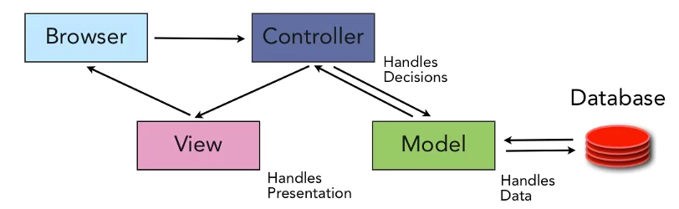
3) Rails Platform
Notes:
Once we have the front end all set up, and we have the data we need stored stored in a database, we need to share our site ONLINE! That is where the platform comes in.
We will be using the ‘rails’ platform called: RUBY ON RAILS

Slide 12

Thank You!
Especially: Aviva Childress, Riva Tropp, Daniella Penn, Atara Huberfeld, Ilana Radinsky, Gal Gir, Racheli Moskowitz, Ahuva Hoverman, Chana Schiffmiller & Meredith Shapiro

